Slide 1

CubeSat -Control Preliminary Design Review
November 1, 2024
Notes:
title slide

Slide 2
PDR Overview (1/2)
Attitude Control Subsystem Description
Orbit Timeline
Design Criteria
Actuators
Reaction Wheels
Magnetorquers
Sensors
Star Trackers
Sun Sensors
IMU
Magnetometer
Notes:
title slide

Slide 3
PDR Overview (2/2)
Control System
Control Diagram
Board Layout
Control Weight
Power Consumption
Risk Mitigation
Reference Frames
ICRF Coordinates
Preliminary Subsystem Analysis
Gantt Chart
Budget/Cost Estimate
Software
Notes:
title slide

Slide 4
Attitude Control System (ACS) Description
Our CubeSat's ACS is designed to stabilize and precisely orient the satellite in space. After launch, magnetorquers are used to stop any tumbling by interacting with Earth's magnetic field. Once stabilized, reaction wheels provide fine control to point the CubeSat at specific targets, such as Utah, for photography. The primary attitude sensing is handled by the star tracker, with sun sensors as a backup. Additional data from the IMU and magnetometer ensure real-time attitude determination and accurate control throughout the mission.
Notes:
title slide

Slide 5
Ejection Timeline
Use magnetometer and magnetorquer to align CubeSat with Earth's magnetic field
Run start up code to help
Notes:
title slide

Slide 6
Orbit Timeline
Before the CubeSat is either 48.8 deg (for 400km altitude) or 9.49 deg (for 600km altitude) from Utah the reaction wheels will rotate the CubeSat from its parked orientation to making the payload end pointing at where we want to take the photo.
CubeSat will track the position for 12ms while the photo is being taken by rotating 0.018 rad/sec^2
Point at next location
Repeat steps 2 and 3 till Utah is too far away (depending on altitude) about 5 min.
Use reaction wheels to move CubeSat back into its parking orientation.
Notes:
title slide

Slide 7
Design Criteria
Loads:
Must withstand random vibration of 10 Grms 1 min per axis
Must withstand bakeout of 100C for 24 hours
Estimated temperature cycling –25C to 25C
Material allowables
Aluminum 6061
Electronic component temperature allowable: Derated from 125C
Power, current, and voltage for all electric components will be also be derated.
Power: 50-70%
Current: 50-75%
Voltage: 50-80%
Notes:
title slide

Slide 8
Actuators
Reaction Wheels
Magnetorquer
Notes:
title slide

Slide 9
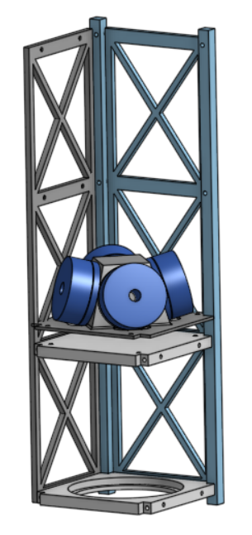
Reaction Wheel
For precise control of the CubeSat’s orientation.
Accelerating the motor in one direction accelerates the CubeSat in the opposite direction.
Will allow us to point our CubeSat with accuracy of ...
Need to have accuracy of...
Redundancy: In this configuration only 3 motors are required so if one goes out it will function the same.
Notes:
title slide

Slide 10
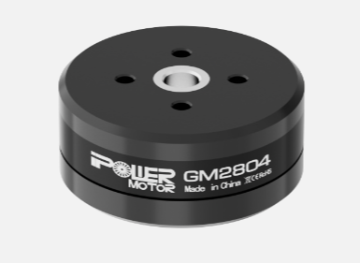
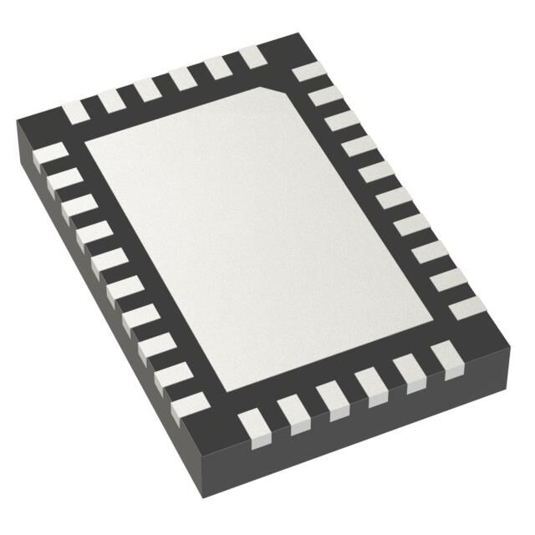
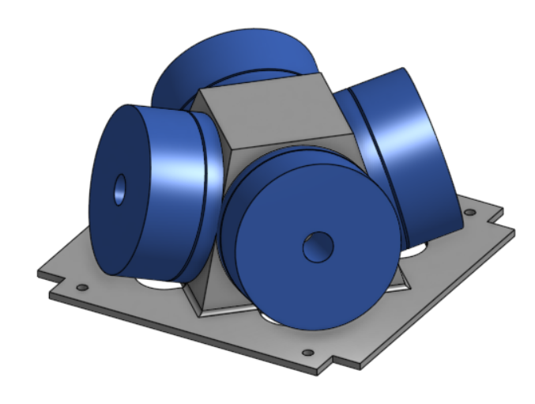
Preliminary Subsystem Design – Reaction Wheel
4- GBM4008H-150T Gimbal Motors 112 g each
Max Torque 1.9 kgf-cm
Voltage: 12V
12- Hall Effect Sensors
10.909 degrees between each sensor
4- MCT8315Z0HRRYR Motor Drivers
Operating Temp: -40C to 125C
1- 6061 Aluminum Frame (Machined in house) 152 g
Operating Temp: -180C to 260C
Key interfaces: Control Board, Power
Design margins: Max torque required 33mNm
Motor can provide 186mNm
Notes:
title slide

Slide 11
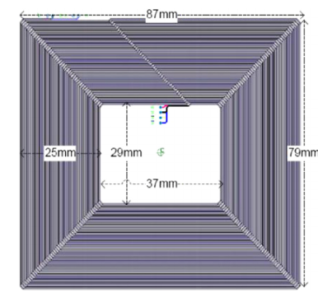
Magnetorquers
For momentum dumping and detumbling using the Earth's magnetic field.
Electromagnets that interact with Earth’s magnetic field to produce a torque
Can achieve modest pointing accuracy
Notes:
https://www.researchgate.net/publication/259509038_Innovative_power_management_attitude_determination_and_control_tile_for_CubeSat_standard_NanoSatellites
https://www.researchgate.net/publication/357488533_Optimized_Design_and_Analysis_of_Printed_Magnetorquer_for_a_3-U_Nano-Satellite -American Society of Civil Engineers

Slide 12
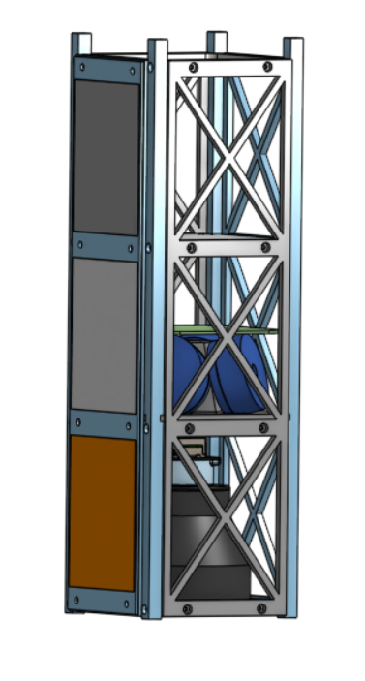
Preliminary Subsystem Design - Magnetorquers
3 Magnetorquers
1 X-Z on Solar Panel PCB
1 Y-Z on Solar Panel PCB
1 X-Y on Control PCB
Key interfaces: Control Board, Magnetometer
If one of the magnetorquers goes out the reaction wheels will step in and help
Examples of it being done
Journal of Aerospace Engineering
Acta Astronautica
Design margins
Put all the numbers/number of winding
Notes:
https://www.researchgate.net/publication/259509038_Innovative_power_management_attitude_determination_and_control_tile_for_CubeSat_standard_NanoSatellites
https://www.researchgate.net/publication/357488533_Optimized_Design_and_Analysis_of_Printed_Magnetorquer_for_a_3-U_Nano-Satellite-American Society of Civil Engineers

Slide 13
Sensors
IMU
Magnetometer
Star Tracker
Sun Sensors
Notes:
title slide

Slide 14
Preliminary Subsystem Design - Sensors
Star Tracker: For high-precision attitude determination using star fields.
40 deg lens
Goal update every 250ms
5 Sun Sensors (K857PE)(Redundant): For determining the Sun's position
IMU (LSM6DSOXTR)
Magnetometer (LIS3MDLTR)
(Digital output magnetic sensor: Ultra Power, High-Performance 3-axis magnetometer. (+-) 4-16 gaus. Operational temperature, (-40) - (+85) degrees Celsius. Wide supply voltage, 1.9-3.6 V. Independent IO supply, 1.8 V. 16 bit data output. equipped with power down and low power mode.(mass, size, volts/amps required.)
Notes:
Preliminary drawings/schematics
Key interfaces
Design margins
Identify what part of subsystem is redundant and what is not

Slide 15
Control System
Linear–Quadratic Regulator (LQR)
Goal is to minimize the cost function
Tune gains of cost function to get best performance
LQR help us not over use the reaction wheels
EKF
PID for reaction wheels
Notes:
title slide

Slide 16
Control Diagram
Linear–Quadratic Regulator (LQR)
LQR Diagram
Notes:
title slide

Slide 17
Board Layout
Drawing.vsdx
Notes:
title slide

Slide 18
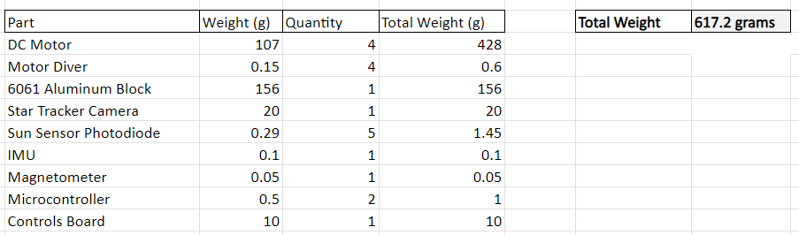
Control Weight
Add 20% contingency on weight budget. So show estimated weight as you have. And then show weight with 20% contingency.
Notes:
Preliminary drawings/schematics
Key interfaces
Design margins
Identify what part of subsystem is redundant and what is not

Slide 19
Power Consumption
Notes:
Preliminary drawings/schematics
Key interfaces
Design margins
Identify what part of subsystem is redundant and what is not

Slide 20
Risk Mitigation
Risk | Failure | Risk Mitigation | Probability of Failure
Lose control of one DC motor. | Loss of any number of motors could lead to change in programing, that would compromise current programing. | Loss of one motor- The reaction wheels can keep orientation with three reaction wheels. | Failure Rates ranging from 1% to 5% over their operational life, 5 years.
Lose control of two DC motors | Loss of any number of motors could lead to change in programing that would compromise current programing. | Loss of two motors- the solution would be a combination of magnetorquer's and reaction wheels. | Failure Rates ranging from 1% to 5% over their operational life, 5 years.
The star tracker does not work as planned, and we have no way of tracking orientation. | If the sun sensors, and magnetometer fail, we will have no understanding of orientation, and the cube sat will not be able to orient itself for pictures. | The sun sensors, although not as precise, can provide information if the star tracker fails. If the sun sensors fail, the magnetometer will be able to supply information about orientation.
The control algorithm that we are implementing does not work properly. The code we upload was correct but does not work. | The code is inadequate and we lose control of the magnetorquers | The code is sent through the ground station and replaces inaccurate code.
Notes:
title slide

Slide 21
ICRF Coordinates
ICRF stands for International Celestial Reference Frame, and is mainly used for the navigation of the CubeSat because:
Accurate Navigation and Tracking: ICRF is a high-precision, stable reference frame based on the positions of distant quasars, which are nearly fixed relative to Earth. Using this frame helps in accurately determining and predicting the spacecraft's position and orientation in space over time.
Standardized Communication: ICRF is the standard reference system for astronomy and space science, allowing consistent communication and comparison of spacecraft position and orientation between different agencies and systems (like ground stations, tracking systems, etc.).
Global Alignment: As CubeSats orbit Earth and interact with other spacecraft or celestial objects, it’s essential to have a frame that remains globally aligned. ICRF provides that global consistency because it is independent of Earth's rotation, which can vary slightly over time due to phenomena like polar motion.
We are using ICRF because with a star tracker, we can use the ICRF to determine their attitude (orientation in space). Star trackers compare images of known stars to the ICRF catalog to accurately calculate the CubeSat’s orientation, which is critical for navigation, scientific observations, and communication alignment.
Notes:
title slide

Slide 22
ICRF Coordinates
We created a matlab code that calculates the ICRF coordinates from langitude and longitude coordinates.
After getting numbers based off of Salt Lake City, Utah, I then checked my numbers using the NASA Spice toolkit used in MATLAB.
After running there code, my code was only off by a couple of meters, which is a huge success in making sure that what the toolkit outputs was correct.
I messed around with different dates and times to make sure and I was still getting similar values.
Notes:
title slide

Slide 23
Preliminary Subsystem Analysis
Structural and thermal analysis showing design margins
Electronic circuit board analysis showing design margins
Notes:
title slide

Slide 24
Schedule via a Gannt chart
Key milestones, other significant subsystem events
Hardware start/completion
Software start/completion
Gantt Chart.xlsx
https://www.dropbox.com/scl/fi/5zhnrk99taoojvrz56e43/Gantt-Chart-Controls.xlsx?rlkey=wolo322l11mj7b0qrr6ced9mf&st=vdhkres6&dl=0
Notes:
title slide

Slide 25
Budget/Cost Estimate
Budget: $1500
Prototype or engineering unit
Flight unit
Tooling
Testing and test hardware
Notes:
title slide

Slide 26
Software/Mechanical
Estimate of lines of code: 3000
Mechanical:
Key software interfaces: Command (Sensors) Who am I talking to
Notes:
title slide

